Slide 1
80386 Microprocessor
Farhan Sadaf
Lecturer, Dept. of CSE

Slide 2
Introduction
The Intel 80386 microprocessor was designed to overcome the limitations of Intel 80286, while maintaining software compatibility with the 80286 and earlier processors.
The 80386 has a 32-bit ALU, so it can operate directly on 32-bit data words.
80386 segments can be as large as 4 Gbytes and a program can have as many as 16384 segments.
The virtual address space then is 16384 X 4 Gbytes or about 64 Tbytes.
A 32-bit address bus allows an 80386 to address up to 4 Gbytes of physical memory.
The 80386 has a “virtual 8086” mode, which allows it to easily switch back and forth between protected and real mode tasks.

Slide 3
Introduction
The 80386 family of microprocessors of Intel Corporation is the first 32 bit version of the 8086 family-a switch from 16 bit to 32 bit.
80386 has upward compatibility with 8086,8088,80286 etc .
The 80386 was launched in October 1985, but full-function chips were first delivered in the third quarter of 1986.
Although it had long been obsolete as a personal computer CPU, Intel and others had continued making the chip for embedded systems.
Used in aerospace technology

Slide 4
Versions of 80386
Two versions of 80386 are commonly available:
1) 80386DX
2)80386SX
80386DX 80386SX
32 bit address bus 1) 24 bit address bus 32bit data bus 16 bit data bus
Packaged in 132 pin ceramic 2) 100 pin flat
pin grid array(PGA) package
3) Address 4GB of memory 3) 16 MB of
memory

Slide 5
80386SX was developed after the DX for application that didn’t require the full 32-bit bus version. It is found in many PCs use the same basic mother board design as the 80286.Most application less than the 16MB of memory ,so the SX is popular and less costly version of the 80386 microprocessor.
The 80386 CPU supports 16k no of segments and thus total virtual memory space is 4GB *16k = 64 Tera bytes
Memory management section supports
Virtual memory
Paging
4 levels of protection

Slide 6
Architecture of 80386
The Internal Architecture of 80386 is divided into 3 sections.
Central processing unit (CPU)
Memory management unit (MMU)
Bus interface unit (BIU)
Central processing unit is further divided into Execution unit(EU) and Instruction unit(IU)
Execution unit has 8 General purpose and 8 Special purpose registers which are either used for handling data or calculating offset addresses.

Slide 7
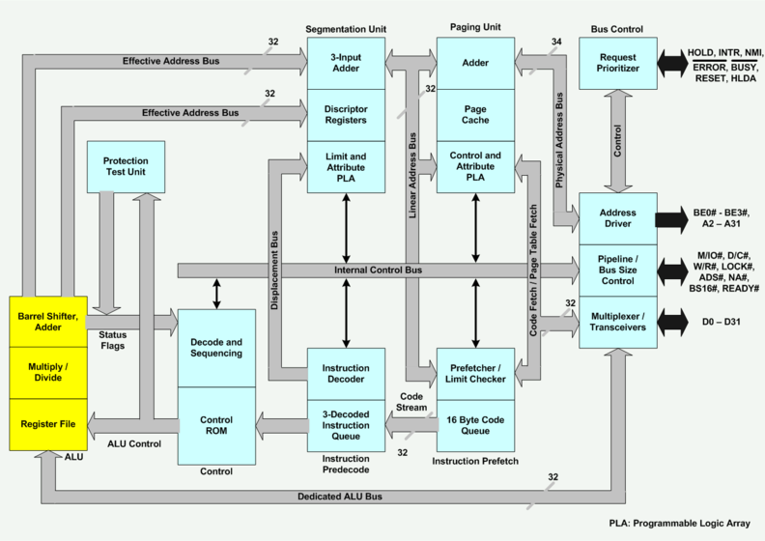

Slide 8
Architecture of 80386
The Instruction unit decodes the opcode bytes received from the 16-byte instruction code queue and arranges them in a 3-byte instruction decoded instruction queue.
After decoding them pass it to the control section for deriving the necessary control signals.
The barrel shifter increases the speed of all shift and rotate operations.
The multiply / divide logic implements the bit-shift-rotate algorithms to complete the operations in minimum time.
Even 32- bit multiplications can be executed within one microsecond by the multiply / divide logic.

Slide 9
The Memory management unit consists of
Segmentation unit and
Paging unit.
Segmentation unit allows the use of two address components, viz. segment and offset for relocatable and sharing of code and data.
Segmentation unit allows segments of size 4Gbytes at max.
The Paging unit organizes the physical memory in terms of pages of 4Kbytes size each.
Paging unit works under the control of the segmentation unit, i.e. each segment is further divided into pages. The virtual memory is also organizes in terms of segments and pages by the memory management unit.

Slide 10
Virtual, Linear, and Physical Addresses
Virtual addresses consist of a 16-bit selector and a 32-bit offset. In the flat memory model, the selectors are preloaded into segment registers CS, DS, SS, and ES, which all refer to the same linear address.
Linear addresses are calculated from virtual addresses by segment translation. The base of the segment referred by the selector is added to the virtual offset, giving a 32-bit linear address.
Physical addresses are calculated from linear addresses through paging. The linear address is used as an index into the Page Table where the CPU locates the corresponding physical address.

Slide 11
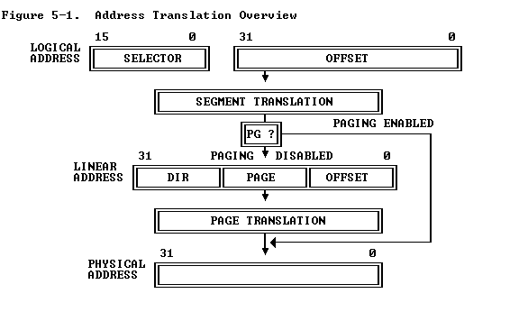
Virtual, Linear, and Physical Addresses

Slide 12
The Segmentation unit provides a 4 level protection mechanism for protecting and isolating the system code and data from those of the application program.
Paging unit converts linear addresses into physical addresses.
The control and attribute PLA checks the privileges at the page level. Each of the pages maintains the paging information of the task. The limit and attribute PLA checks segment limits and attributes at segment level to avoid invalid accesses to code and data in the memory segments.
The Bus control unit has a prioritizer to resolve the priority of the various bus requests. This controls the access of the bus. The address driver drives the bus enable and address signal A0 – A31. The pipeline and dynamic bus sizing unit handle the related control signals.
The data buffers interface the internal data bus with the system bus.

Slide 13
The Bus Unit
The bus unit is the interface to the external devices.
The bus interface unit provides a 32-bit data bus, a 32-bit address bus and the signals needed to control transfers over the bus.
In fact, 8-bit, 16-bit and 32-bit data transfers are supported.
80386 has separate pins for its address and data bus lines.
This processing unit contains the latches and drivers for the address bus, transceivers for the data bus, and control logic for signaling whether a memory input/output, or interrupt-acknowledgement bus cycle is to be performed.

Slide 14
The prefetch unit
The prefetch unit performs a mechanism known as an instruction stream queue.
This queue permits a prefetch upto 16 bytes of instruction code.
Whenever the queue is not full, and the execution unit is not asking the bus unit to read or write data from the memory, the prefetch queue supplies addresses to the bus interface unit and signals it to look ahead in the program by fetching the next sequential instructions.
Prefetched instructions are held in the FIFO queue for use by the instruction decoder.
Whenever bytes are loaded into the input end of the queue, they are automatically shifted up through the FIFO to the empty location near the output.

Slide 15
The decode unit
The decode unit accesses the output end of the prefetch unit’s instruction queue.
It reads the machine-code instructions from the output side of the prefetch queue and decodes them into microcode instruction format used by the execution unit, thus it off-loads the responsibility for the instruction decoding from the instruction unit.
The instruction queue, a part of the decode unit permits three fully decoded instructions to be held waiting for use by the execution unit.
Thus it improves the performance of the CPU.

Slide 16
The execution unit
The execution unit involves the arithmetic/logic unit-ALU, registers, special multiply, divide, and shift hardware, and a control ROM.
The control ROM contains the microcode sequences that define the operation performed by each of the machine code instructions.
The execution unit reads the decoded instructions from the instruction queue and performs the operations that are specified.
During the execution of an instruction, it requests the segment and page units to generate operand addresses and the bus interface unit to perform read or write bus cycles to access data in memory or I/O devices.

Slide 17
The page and segment unit
The segment and the Page units provide the memory management and protection services for the 80386.
They offload the responsibility for address generation, address translation and segment checking from the bus interface unit and thereby further boosting the performance of the CPU.
The segment unit implements the segmentation model of the 386 memory management.
i.e. It contains dedicated hardware for performing high speed address calculations, logical to linear address translation and protection checks.

Slide 18
The page and segment unit
The page unit implements the protected mode paging model of the 80386’s memory management.
It contains the translation look aside buffer that stores recently used page directory and page table entries.
When paging is enabled, the linear address produced by the segment unit is used as the input to the paging unit.
Here the linear address is translated into the physical address of the memory or I/O location to be accessed. Thus physical memory is the output to the bus interface unit.

Slide 19
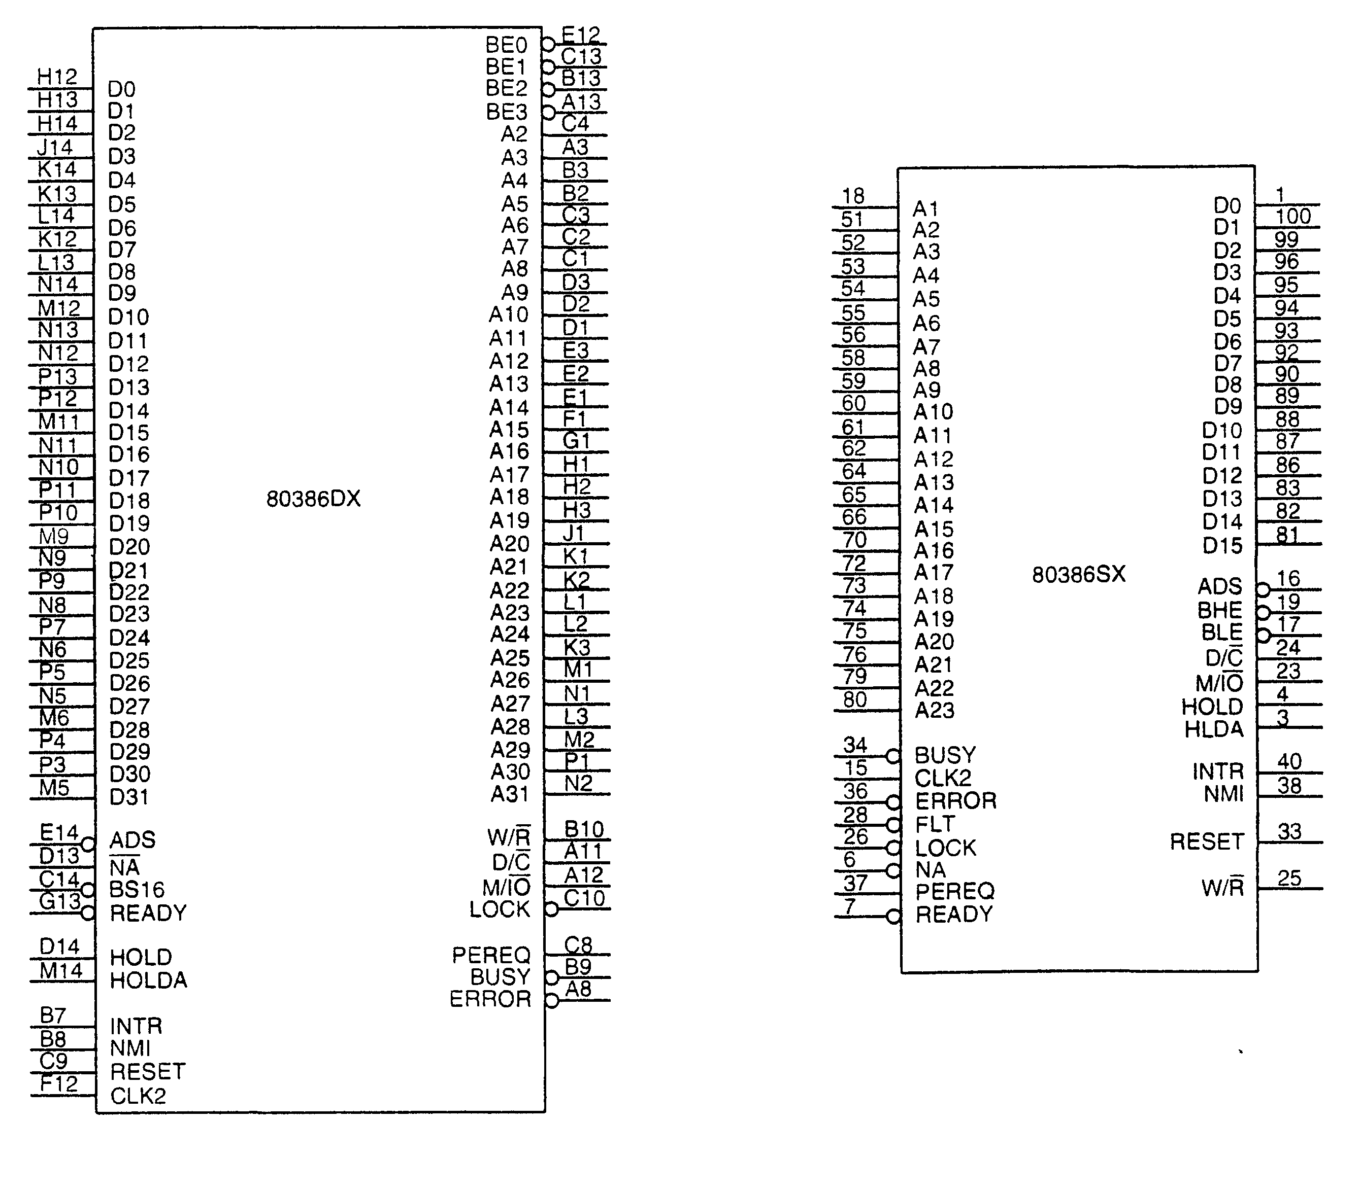
PIN DIAGRAM OF 80386

Slide 20
Pin Descriptions of 80386
CLK2:The input pin provides the basic system clock timing for the operation of 80386.
D0 – D31:These 32 lines act as bidirectional data bus during different access cycles.
A31 – A2: These are upper 30 bit of the 32- bit address bus.
BE0# to BE3#: The 32- bit data bus supported by 80386 and the memory system of 80386 can be viewed as a 4- byte wide memory access mechanism. The 4 byte enable lines BE0# to BE3# , may be used for enabling these 4 blanks. Using these 4 enable signal lines, the CPU may transfer 1 byte / 2 / 3 / 4 byte of data simultaneously.

Slide 21
Pin Descriptions of 80386
WR/R#: This signal indicates whether a read or write operation is taking place.
D/C#: It indicates whether the bus operation is a data read/write or a control word transfer such as an opcode fetch.
M/IO#: This signal indicates whether the operation is a memory or a direct input/output operation.
VCC: These are system power supply lines.

Slide 22
Pin Descriptions of 80386
ADS#: The address status output pin indicates that the address bus and bus cycle definition pins( WR/R#, D/C#, M/IO#, BE0# to BE3# ) are carrying the respective valid signals. The 80383 does not have any ALE signals and so this signals may be used for latching the address to external latches.
READY#: The ready signals indicates to the CPU that the previous bus cycle has been terminated and the bus is ready for the next cycle. The signal is also used to insert WAIT states in a bus cycle and is useful for interfacing of slow devices with CPU.

Slide 23
Pin Descriptions of 80386
BS16#: The bus size – 16 input pin allows the interfacing of 16 bit devices with the 32 bit wide 80386 data bus. Successive 16 bit bus cycles may be executed to read a 32 bit data from a peripheral.
HOLD: The bus hold input pin enables the other bus masters to gain control of the system bus if it is asserted.
HLDA: The bus hold acknowledge output indicates that a valid bus hold request has been received and the bus has been relinquished by the CPU.
BUSY#: The busy input signal indicates to the CPU that the coprocessor is busy with the allocated task.

Slide 24
Pin Descriptions of 80386
ERROR#: The error input pin indicates to the CPU that the coprocessor has encountered an error while executing its instruction.
PEREQ: The processor extension request output signal indicates to the CPU to fetch a data word for the coprocessor.
INTR: This interrupt pin is a maskable interrupt, that can be masked using the IF of the flag register.
NMI: A valid request signal at the non-maskable interrupt request input pin internally generates a non- maskable interrupt of type2.

Slide 25
Pin Descriptions of 80386
RESET: A high at this input pin suspends the current operation and restart the execution from the starting location.
N / C# : No connection pins are expected to be left open while connecting the 80386 in the circuit.

Slide 26
Register Organization
The 80386 has eight 32 - bit general purpose registers which may be used as either 8 bit or 16 bit registers.
A 32 - bit register known as an extended register, is represented by the register name with prefix E.
Example : A 32 bit register corresponding to AX is EAX, similarly BX is EBX etc.
The 16 bit registers BP, SP, SI and DI in 8086 are now available with their extended size of 32 bit and are names as EBP,ESP,ESI and EDI.
AX represents the lower 16 bit of the 32 bit register EAX.

Slide 27
Register Organization
BP, SP, SI, DI represents the lower 16 bit of their 32 bit counterparts, and can be used as independent 16 bit registers.
The six segment registers available in 80386 are CS, SS, DS, ES, FS and GS.
The CS and SS are the code and the stack segment registers respectively, while DS,ES,FS,GS are 4 data segment registers.
A 16 bit instruction pointer IP is available along with 32 bit counterpart EIP.

Slide 28
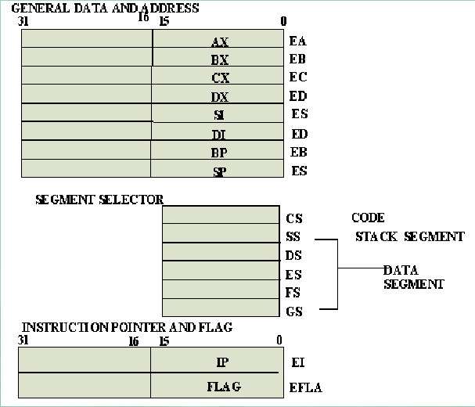

Slide 29
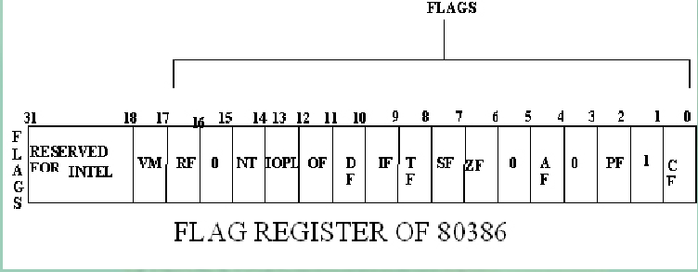
Flag Register of 80386: The Flag register of 80386 is a 32 bit register. Out of the 32 bits, Intel has reserved bits D18 to D31, D5 and D3, while D1 is always set at 1.Two extra new flags are added to the 80286 flags to derive the flag register of 80386. They are VM and RF flags.

Slide 30
VM - Virtual Mode Flag: If this flag is set, the 80386 enters the virtual 8086 mode within the protection mode. This is to be set only when the 80386 is in protected mode. Virtual mode allows the execution of real mode applications that are incapable of running directly in protected mode while the processor is running a protected mode operating system. In this mode, if any privileged instruction is executed, an exception 13 is generated. This bit can be set using IRET instruction or any task switch operation only in the protected mode.
RF- Resume Flag: This flag is used with the debug register breakpoints. It is checked at the starting of every instruction cycle and if it is set, any debug fault is ignored during the instruction cycle. The RF is automatically reset after successful execution of every instruction, except for IRET and POPF instructions.

Slide 31
Also, it is not automatically cleared after the successful execution of JMP, CALL and INT instruction causing a task switch. These instruction are used to set the RF to the value specified by the memory data available at the stack.

Slide 32
•Segment Descriptor Registers: This registers are not available for programmers, rather they are internally used to store the descriptor information, like attributes, limit and base addresses of segments.
•The six segment registers have corresponding six 73 bit descriptor registers. Each of them contains 32 bit base address, 32 bit base limit and 9 bit attributes. These are automatically loaded when the corresponding segments are loaded with selectors.
•Control Registers: The 80386 has three 32 bit control registers CR0, CR2 and CR3 to hold global machine status independent of the executed task. Load and store instructions are available to access these registers.
•System Address Registers: Four special registers are defined to refer to the descriptor tables supported by 80386.

Slide 33
ADDRESSING MODES: The 80386 supports overall eleven addressing modes to facilitate efficient execution of higher level language programs.
•In case of all those modes, the 80386 can now have 32-bit immediate or 32- bit register operands or displacements.
•The 80386 has a family of scaled modes. In case of scaled modes, any of the index register values can be multiplied by a valid scale factor to obtain the displacement.
•The valid scale factor are 1, 2, 4 and 8.
•The different scaled modes are as follows:
•Scaled Indexed Mode: Contents of the an index register are multiplied by a scale factor to get the operand offset.

Slide 34
•Based Scaled Indexed Mode: Contents of the an index register are multiplied by a scale factor and then added to base register to obtain the offset.
•Based Scaled Indexed Mode with Displacement: The Contents of the an index register are multiplied by a scaling factor and the result is added to a base register and a displacement to get the offset of an operand.

Slide 35
Real Address Mode of 80386
After reset, the 80386 starts from memory location FFFFFFF0H under the real address mode. In the real mode, 80386 works as a fast 8086 with 32-bit registers and data types.
In real mode, the default operand size is 16 bit but 32- bit operands and addressing modes may be used.
The segment size in real mode is 64k, hence the 32-bit effective addressing (offset) must be less than 0000FFFFFH. The real mode initializes the 80386 and prepares it for protected mode.

Slide 36
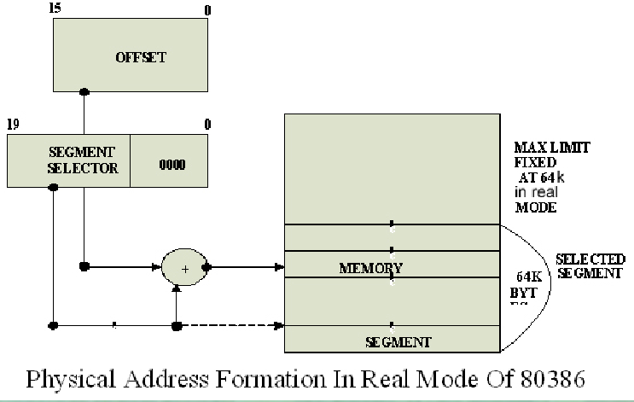
Real Address Mode of 80386

Slide 37
Memory Addressing in Real Mode
In the real mode, the 80386 can address at the most 1Mbytes of physical memory using address lines A0-A19.
Paging unit is disabled in real addressing mode, and hence the real addresses are the same as the physical addresses.
To form a physical memory address, appropriate segment registers contents (16-bits) are shifted left by four positions and then added to the 16-bit offset address formed using one of the addressing modes, in the same way as in the 80286 real address mode.

Slide 38
Memory Addressing in Real Mode
The segment in 80386 real mode can be read, write or executed, i.e. no protection is available.
Any fetch or access past the end of the segment limit generate exception 13 in real address mode.
The segments in 80386 real mode may be overlapped or non-overlapped.
The interrupt vector table of 80386 has been allocated 1Kbyte space starting from 00000H to 003FFH.

Slide 39
Protected Mode of 80386
All the capabilities of 80386 are available for utilization in its protected mode of operation.
The 80386 in protected mode support all the software written for 80286 and 8086 to be executed under the control of memory management and protection abilities of 80386.
The protected mode allows the use of additional instruction, addressing modes and capabilities of 80386.

Slide 40
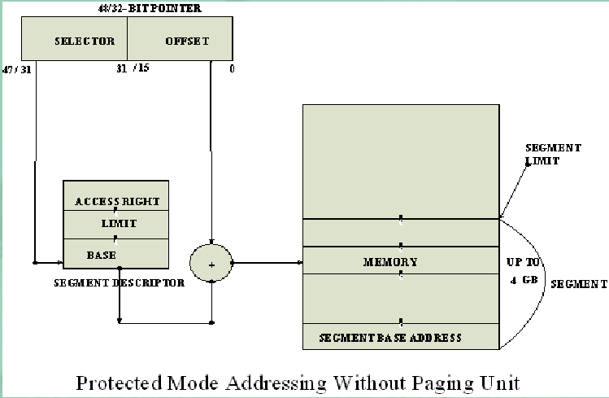
Protected Mode of 80386

Slide 41
ADDRESSING IN PROTECTED MODE
In this mode, the contents of segment registers are used as selectors to address descriptors which contain the segment limit, base address and access rights byte of the segment.
The effective address (offset) is added with segment base address to calculate linear address. This linear address is further used as physical address, if the paging unit is disabled, otherwise the paging unit converts the linear address into physical address.
The paging unit is a memory management unit enabled only in protected mode. The paging mechanism allows handling of large segments of memory in terms of pages of 4Kbyte size.

Slide 42
ADDRESSING IN PROTECTED MODE
The paging unit operates under the control of segmentation unit. The paging unit if enabled converts linear addresses into physical address, in protected mode.
Segmentation:
Descriptor tables: These descriptor tables and registers are manipulated by the operating system to ensure the correct operation of the processor, and hence the correct execution of the program.
Three types of the 80386 descriptor tables are listed as follows:
GLOBAL DESCRIPTOR TABLE ( GDT )
LOCAL DESCRIPTOR TABLE ( LDT )
INTERRUPT DESCRIPTOR TABLE ( IDT )

Slide 43
•Descriptors: The 80386 descriptors have a 20-bit segment limit and 32-bit segment address. The descriptor of 80386 are 8-byte quantities access right or attribute bits along with the base and limit of the segments.
•Descriptor Attribute Bits: The A (accessed) attributed bit indicates whether the segment has been accessed by the CPU or not.
•The TYPE field decides the descriptor type and hence the segment type.
•The S bit decides whether it is a system descriptor (S=0) or code/data segment descriptor ( S=1).
•The DPL field specifies the descriptor privilege level.

Slide 44
•The D bit specifies the code segment operation size. If D=1, the segment is a 32-bit operand segment, else, it is a 16-bit operand segment.
•The P bit (present) signifies whether the segment is present in the physical memory or not. If P=1, the segment is present in the physical memory.
•The G (granularity) bit indicates whether the segment is page addressable. The zero bit must remain zero for compatibility with future process.
•The AVL (available) field specifies whether the descriptor is for user or for operating system.

Slide 45
Segmentation and virtual memory
A 386 is switched from real mode to protected mode by setting the LSB of the CR0 register.
The virtual memory addressing scheme of a 386 in protected mode is very similar to that of the 80286.
In protected mode each 386 address consists of a 16-bit selector and a 32-bit offset.
The selector points to a descriptor for the segment in a table of descriptors and the offset specifies the location of the desired code or data in the segment.
Using 32-bit offset value means that segments can be anywhere from 1 byte in length to 4 Gbytes in length.

Slide 46
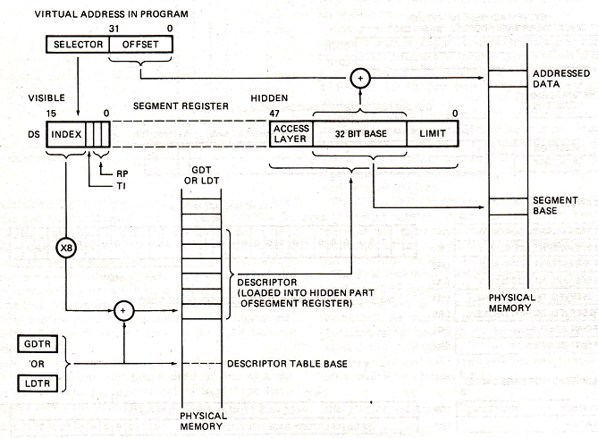

Slide 47
Segmentation and virtual memory
The 13-bit index part of the selector is multiplied by 8 and used as pointer to the desired descriptor in a descriptor table.
The index value is multiplied by 8 because each descriptor requires 8 bytes in the descriptor table.
The descriptor contains the physical base address for the segment.
The MMU adds the base address from the descriptor to the effective address or offset part to the logical address from the instruction to produce the physical memory address.

Slide 48
Segmentation and virtual memory
There are two major categories of descriptor table in a 386 system.
Global descriptor table.
Local descriptor table.
A system has only one global descriptor table or GDT.
GDT contains the segment descriptors for the operating system segments and the descriptors for segments which need to be accessed by all user tasks.
A local descriptor table or LDT is set up in the system for each task or closely related group tasks.

Slide 49
Segmentation and virtual memory
Each task can have its own local descriptor table and memory area defined by the descriptors in it.
Setting up individual LDTs protects tasks from each other because one task cannot access the LDT of another task.
If the table indicator bit TI (bit 2) of a segment selector is a 0, then the upper 13 bits will index a segment descriptor in the global descriptor table.
If the TI bit of the selector is a 1, then the upper 13 bits of the selector will index a segment descriptor in a local descriptor table.

Slide 50
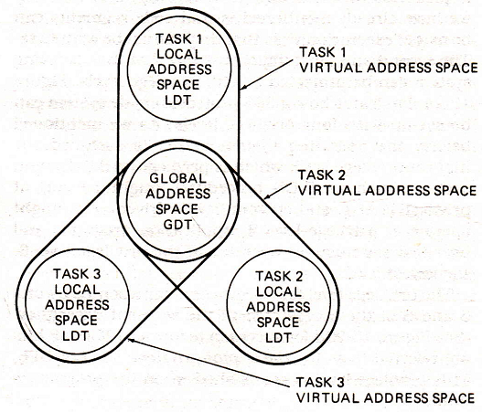
How task can be isolated?

Slide 51
80386 segment privilege levels protection
Self study ☺

Slide 52
How a 80386 computes physical addresses when paging mode is enabled?
Self study ☺

Slide 53
Thank You

